Slide 1
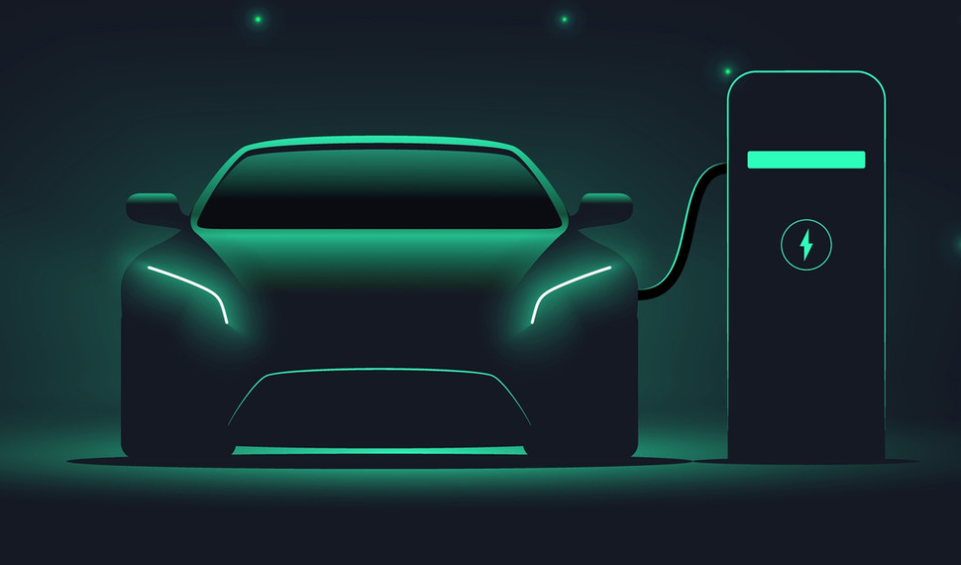
ELECTRIC VEHICLES
WHERE WILL YOU BEGIN
Presented by:
Jason Demone
Anna P.
Hardik Ghelot
Arsam Ijaz
A Study on the Viability of Consumer Interest in Electric Vehicles, the Options Available for interested Parties, and its impact on the United States’ yearly energy consumption demands

Slide 2
Sources
IEA -Consumer and government spending on electric cars, 2015-2020.
Kaggle-Electric & Alternative Fuel Charging Stations 2023

Slide 3
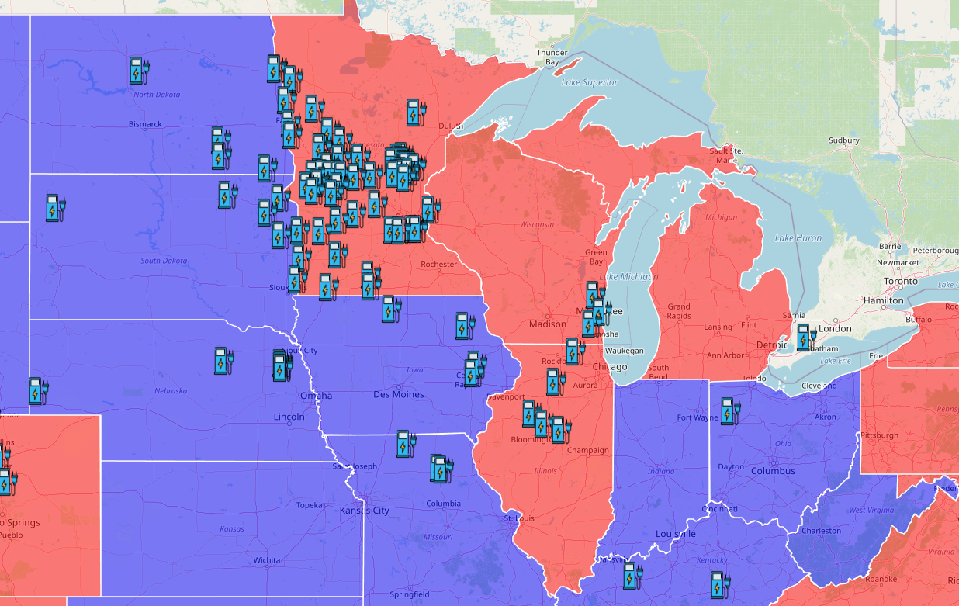
Charging Station Quantity Comparison Based on State Majority Political Affiliation
State funding for electric car chargers is linked to demand, however it’s also linked to the State’s likelihood of considering EV a preferred alternative to gas consumption of automobiles.
The graph displays the frequency of electric charging stations available per state and the state’s affiliation with either the republican party (shown in red), or the Democratic party (shown in blue).

Slide 4
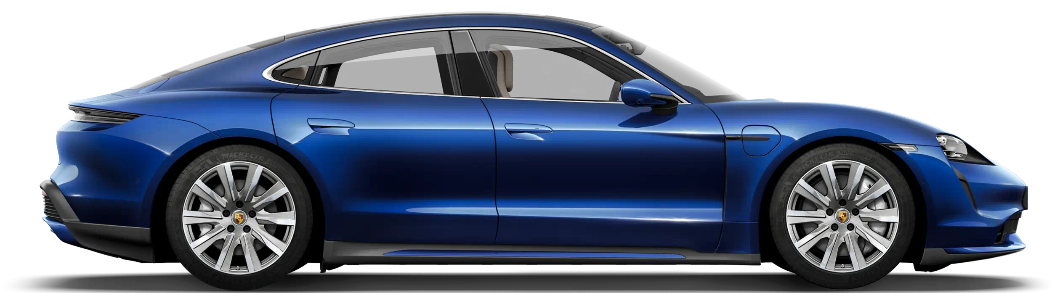
Best and Worst Available EV Models
Anna to add information/conclusion here

Slide 5
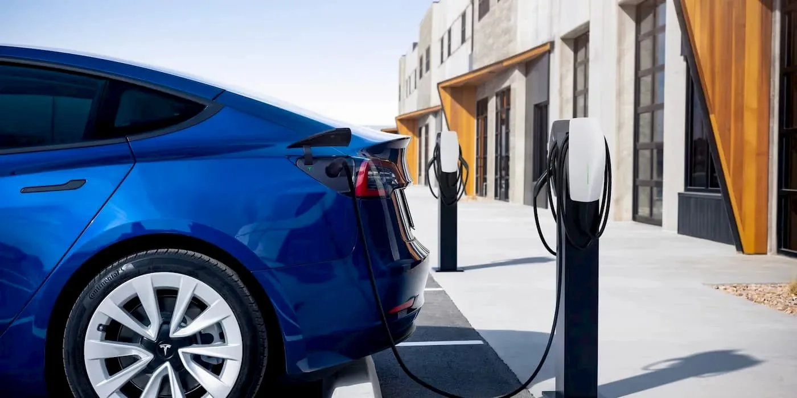
EV Sales Comparison Across Multiple Brands
Anna to add information/conclusion here

Slide 6
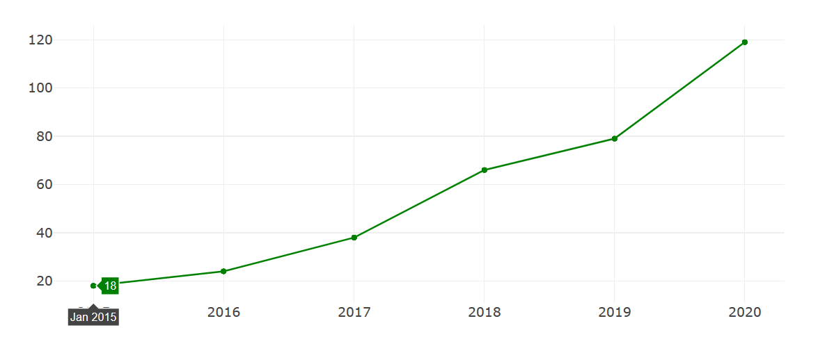
Electric Vehicle market Consumer share
Electric vehicle market is growing
Consumer spending is increasing in EV market
Trust on E-fuel is increasing
Technology and efficiency of E-vehicle is developing which leads increment in different types of E-Vehicle eg truck, SUVs, long distance sedan etc.

Slide 7
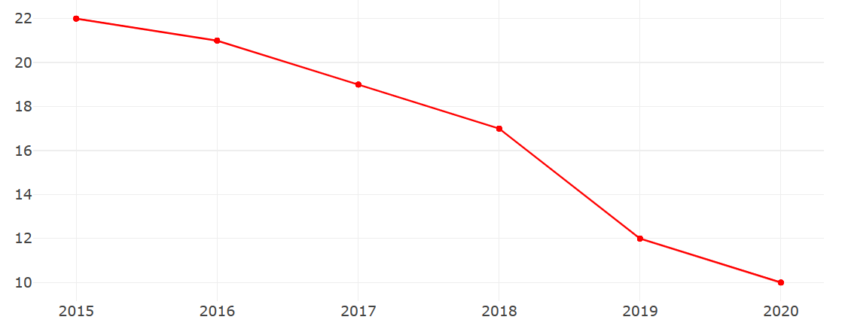
Electric Vehicle market Government share
Government support and share in EV market is going down which shows less support is needed to promote EV market.
More private companies increasing their EV share in the global market

Slide 8
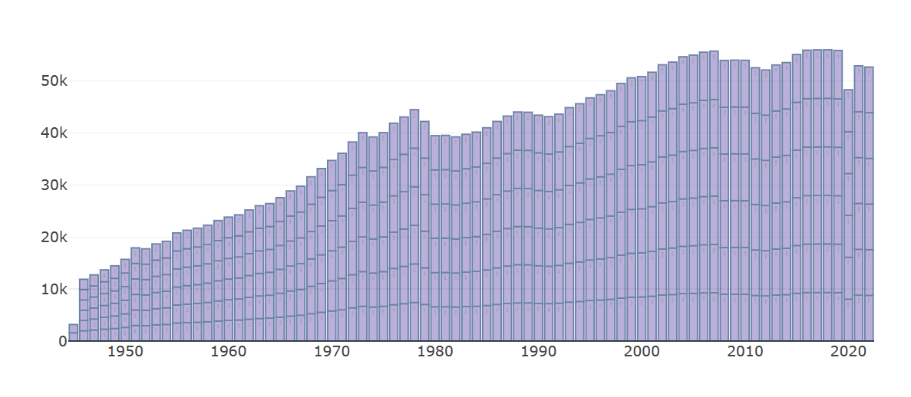
External factors affecting EV market
Barrels consumption per day in USA decreasing steadily.
Increasing Fuel prices in global market caused by Ukraine-Russian war.
Government policies and incentives promoting EV market for common people.
Increasing in Electric vehicles production and sales leading to decreasing usage of traditional fuel.

Slide 9
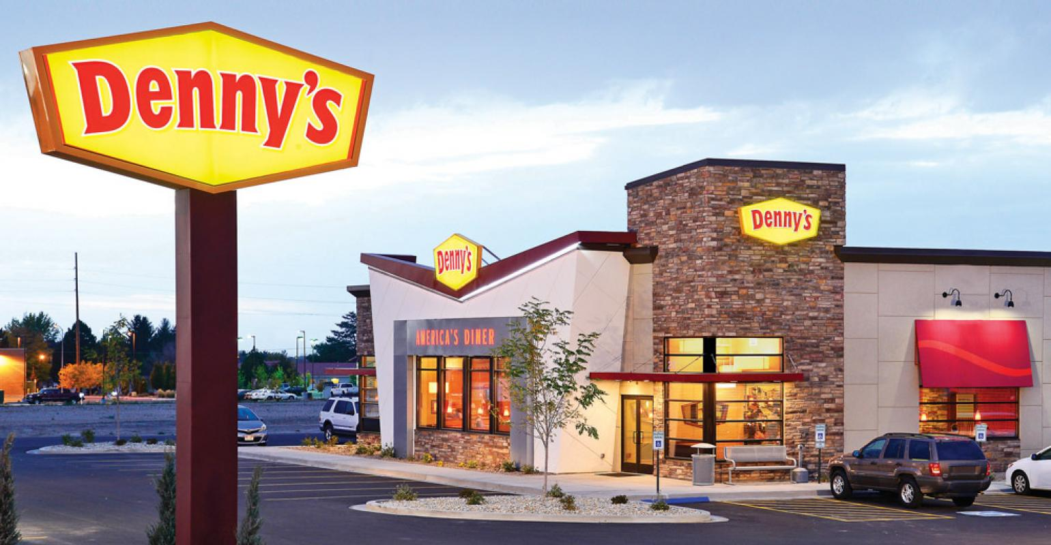
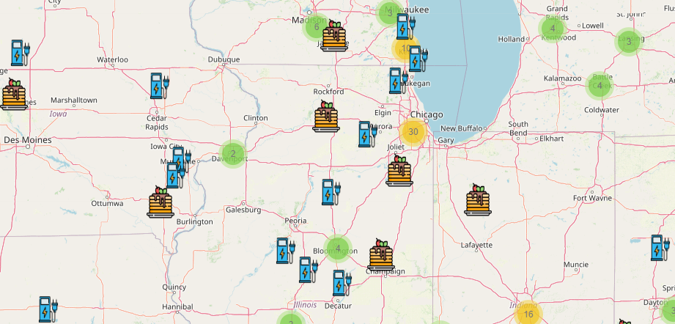
Charging Station Frequency to be Close to Food Stations
We believe it’s as important to ensure we (humans) are fueled for the long drive ahead in addition to our car.
Our tool allows users to identify food stations that are close to charging stations, so that if their car charging time is more than acceptable, they have the opportunity to fuel up as well.

